Slide 1
RDF - Serializaciones

Slide 2
Content
RDF W3C Overview
The basis of RDF
Internationalized Resource Identifier
Literals
Blank Nodes
More features of RDF
RDF Serialisations
Turtle
RDF Vocabularies
RDF on the Web
RDF subleties

Slide 3
RDF Serialisations
Representing graph as linear text (string)
E.g., in a file: reading and writing
Alternative serializations for different needs
- 1. Intuitive for humans to read/write
- N-triples, Notation 3
- Turtle
TriG, N-Quads
2. XML-interpretability for machines
RDF/XML
Existing XML tools available
3. For web programming
JSON-LD
4. Embedding in web pages
RDFa
Publishing information for, e.g., search engines

Slide 4
Format specifications
RDF 1.1 XML Syntax – W3C Recommendation 25 February 2014
https://www.w3.org/TR/rdf-syntax-grammar/RDF 1.1
N-Triples - A line-based syntax for an RDF graph – W3C Recommendation 25 February 2014
https://www.w3.org/TR/n-triples/
JSON-LD 1.0 - A JSON-based Serialization for Linked Data – W3C Recommendation 16 January 2014
https://www.w3.org/TR/json-ld/RDF 1.1
Turtle Terse RDF Triple Language – W3C Recommendation 25 February 2014
https://www.w3.org/TR/turtle/

Slide 5
Content
RDF W3C Overview
The basis of RDF
Internationalized Resource Identifier
Literals
Blank Nodes
More features of RDF
RDF Serialisations
Turtle
RDF Vocabularies
RDF on the Web
RDF subleties

Slide 6
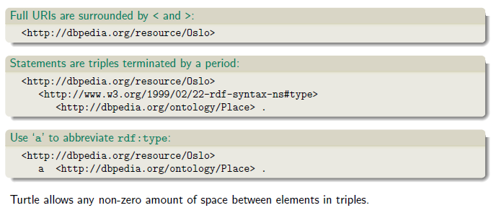
Turtle: URI references and triples

Slide 7
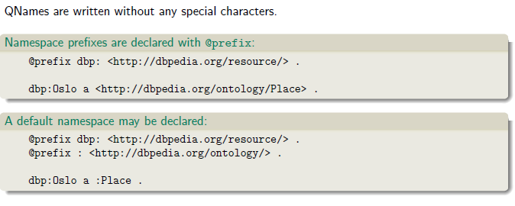
Turtle: Namespaces

Slide 8
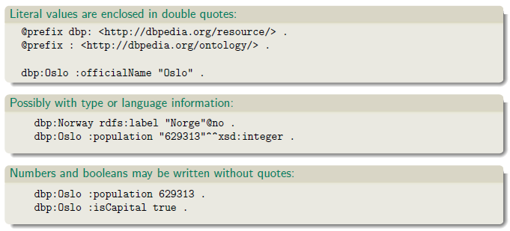
Turtle: Literals

Slide 9
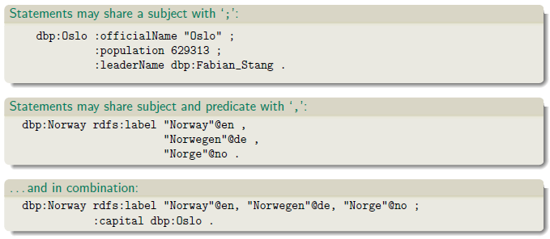
Turtle: Statements sharing elements

Slide 10
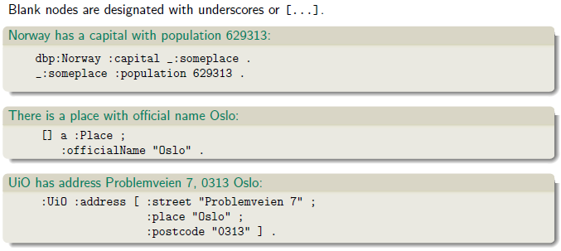
Turtle: Blank nodes

Slide 11
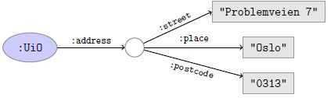
Question
The blank node here:
has no ‘name’
Why does Turtle use ‘blank node identifiers’ like _:someplace?
Answer: makes it easy to use same node in several triples.

Slide 12
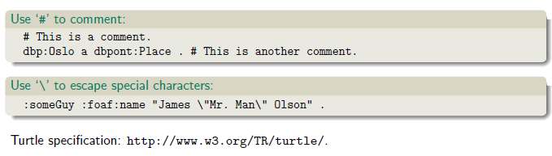
Turtle: Other things

Slide 13
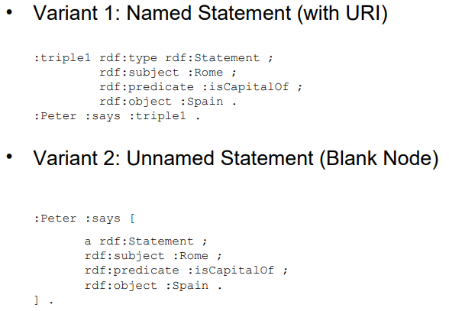
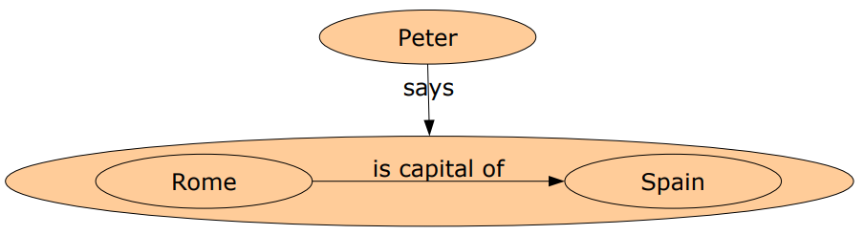
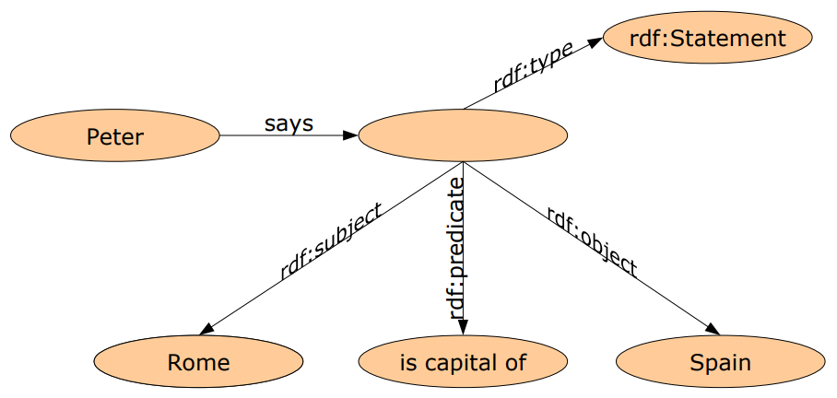
Encoding Reification in Turtle

Slide 14
Práctica 9

Slide 15
Content
RDF W3C Overview
The basis of RDF
Internationalized Resource Identifier
Literals
Blank Nodes
More features of RDF
RDF Serialisations
Turtle
RDF Vocabularies
RDF on the Web
RDF subleties

Slide 16
RDF Vocabularies
Families of related notions are grouped into vocabularies.
Usually the same namespace/prefix is shared.
Some important, well-known namespaces|and prefixes:
rdf: <http://www.w3.org/1999/02/22-rdf-syntax-ns#> - RDF
rdfs: <http://www.w3.org/2000/01/rdf-schema#> - RDF Schema
foaf: <http://xmlns.com/foaf/0.1/> - Friend of a friend
dcterms: <http://purl.org/dc/terms/> - Dublin Core
Usually, a description is published at the namespace base URI.
Note that the prefix is not standardized.
However, in practice many are.
rdf: <http://xmlns.com/foaf/0.1/> would be highly irregular.

Slide 17
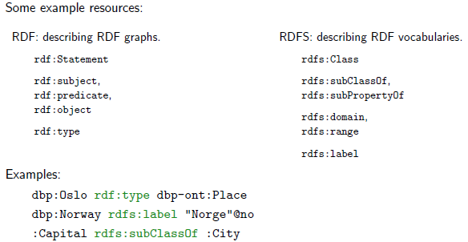
Example vocabularies: RDF, RDFS

Slide 18
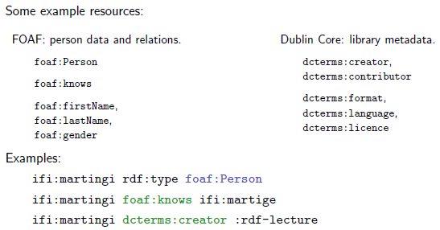
Example vocabularies: FOAF, Dublin Core

Slide 19
RDF Vocabularies
FOAF Vocabulary Specification 0.99
http://xmlns.com/foaf/spec/
Dublin Core Metadata Initiative
http://dublincore.org/documents/dcmi-terms/

Slide 20
Content
RDF W3C Overview
The basis of RDF
Internationalized Resource Identifier
Literals
Blank Nodes
More features of RDF
RDF Serialisations
Turtle
RDF Vocabularies
RDF on the Web
RDF subleties

Slide 21
Where is it?
In files:
In some serialisation: XML/RDF, Turtle, . . .
Typically small RDF graphs, i.e., max. a few 100 triples, e.g.,
Vocabularies: http://xmlns.com/foaf/spec/index.rdf.
Tiny datasets: http://folk.uio.no/martingi/foaf.rdf.
From SPARQL endpoints:
Data kept in a triple store, i.e., a database.
RDF is served from endpoint as results of SPARQL queries.
Exposes data (in different formats)
with endpoint frontends, e.g., http://dbpedia.org/resource/Norway, or
by direct SPARQL query: http://dbpedia.org/sparql.

Slide 22
Where is it?
There are many RDFizers which convert data to RDF.
W3C keeps a list: http://www.w3.org/wiki/ConverterToRdf.

Slide 23
Publishing RDF on the web
Make the URI of your data items dereferencable by using redirects.
Send the request to a page describing the data item.
Distinguish the data item URI from the page that describes it.
Example:
http://dbpedia.org/resource/Ecuador
http://dbpedia.org/data/Ecuador
Make data available in different formats. Typically:
HTML for humans,
RDF for computers.
This is called content negotiation.
Endpoint frontends will do this for you.

Slide 24
Content
RDF W3C Overview
The basis of RDF
Internationalized Resource Identifier
Literals
Blank Nodes
More features of RDF
RDF Serialisations
Turtle
RDF Vocabularies
RDF on the Web
RDF subleties

Slide 25
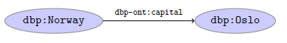
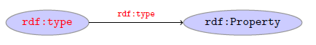
RDF subleties
RDF graphs are not graphs
RDF graphs are sets of triples, not graphs.

Slide 26
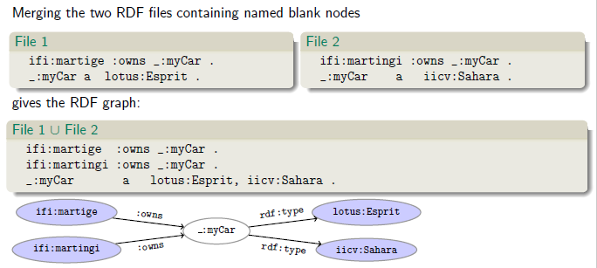
Be careful when merging RDF files

Slide 27
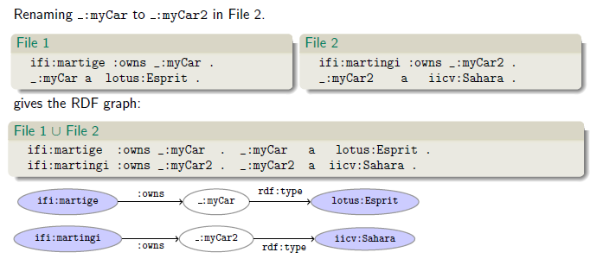
Rename blank nodes

Slide 28

Preguntas?

